Slide 2
State of the art
Simulators
GESTION FEU
VISSIM
Veins + sumo
Open street map + sumo
Rd swarm project
Rerouting
,,,,,
,,,,,,
1
2
3
Notes:
2

Slide 3
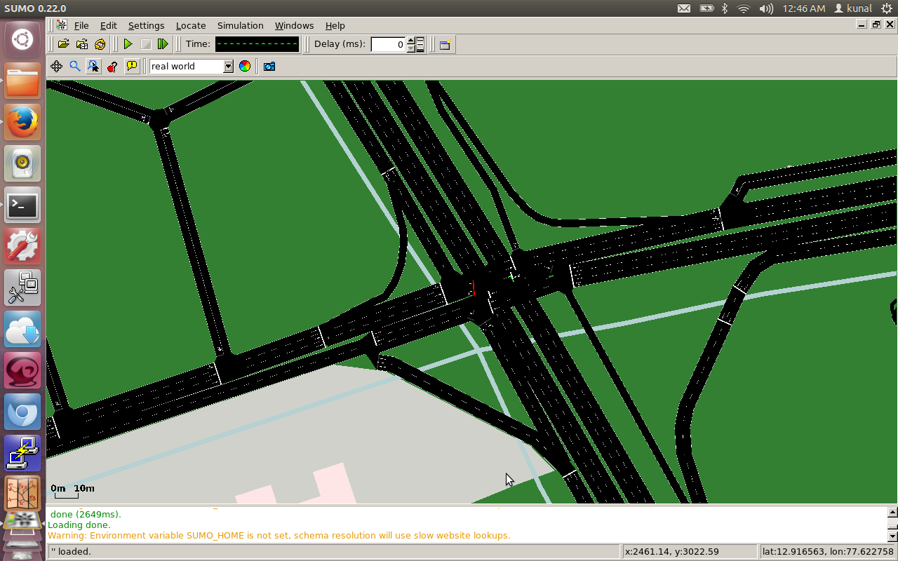
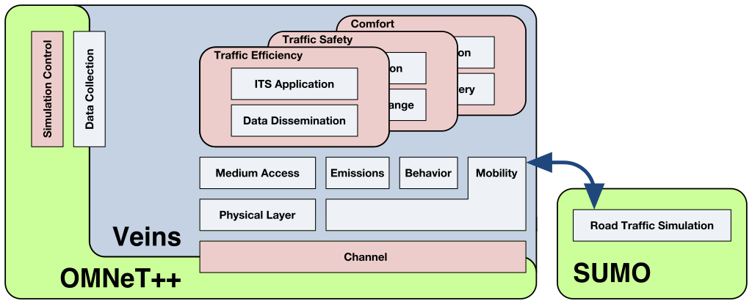
SUMO & VEINS
VEINS = SUMO + OMNET++

Slide 4
SUMO
Research topic
Vehicular communication
Route choice and dynamic navigation
Traffic light algorithms
Evaluation of surveillance system
Projects
iTetris
VABENE
City Mobil

Slide 5
Application
Offline:
Build model of traffic prediction
Online:
Reroute vehicles based on prediction
NoSQL
Server
Smartphone
SUMO

